Slide 1
NLP, TRANSFORMERS

Slide 2
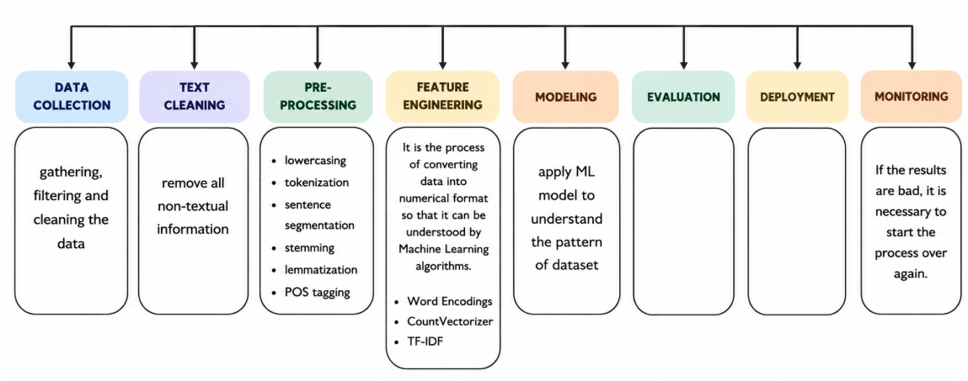
NLP Pipeline
Steps in traditional NLP:
  Text preprocessing (tokenization, stopword removal, stemming/lemmatization)
  Feature extraction (Bag of Words, TF-IDF, embeddings)
  Model building (classification, sentiment analysis, translation)
  Evaluation & deployment
Example: Sentiment analysis of customer reviews

Slide 3
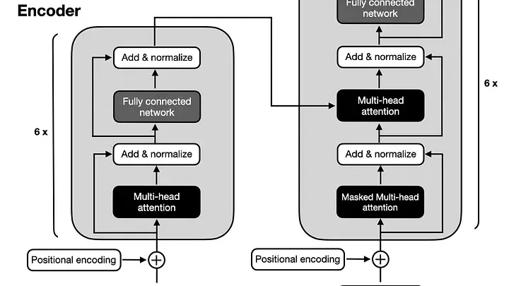
Transformers & Architecture
Key innovation: Attention mechanism
Components:
  Input embeddings
  Multi-head self-attention
  Feed-forward layers
  Residual connections &
  layer normalization
Encoder-decoder structure
(used in translation, summarization)
My name is Khushboo Sachdeva and I am working in Siemens.
Where does Khushboo works?

Slide 4
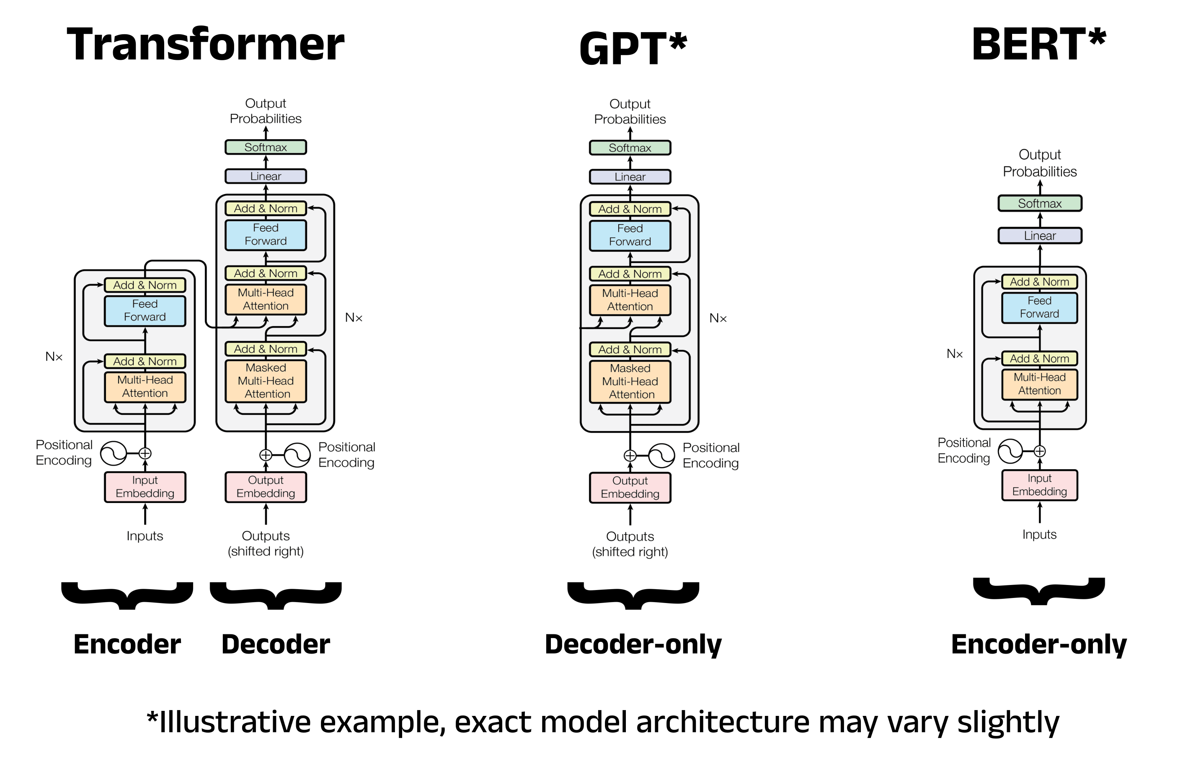

Slide 5
Training a Transformer
Process:
  Input tokens → embeddings
  Attention layers learn relationships
  Predictions compared with ground truth
  Backpropagation updates weights
Requires massive datasets + GPUs/TPUs
Example: GPT trained on billions of words

Slide 6
The Revolutionary NLP Model
BERT (Bidirectional Encoder Representations from Transformers)
  Introduced in 2018 by Google
  Revolutionized NLP with bidirectional context understanding
  Enabled breakthroughs in translation, Q&A, search engines
Other impactful models: GPT, ELMo, Word2Vec
The transformer architecture (2017, Attention Is All You Need) was the turning point.
Models like BERT (2018) and GPT (2018–present) showed that transformers could outperform older NLP methods.
These models bridged the gap between understanding and generation, paving the way for Generative AI.

Slide 7
Why Switch to Generative AI
Limitations of classical NLP:
  Rule-based → brittle
  Feature engineering → manual, time-consuming
  Context understanding → weak
Generative AI advantages:
  Learns context automatically
  Produces creative, human-like outputs
  Scales across multiple tasks without retraining
Motivational note: “Generative AI doesn’t just analyze language — it creates it.”

